Slide 1
SpotMate
CONNECTING COMMUNITIES THROUGH SHARED HANGOUT SPOTS.
  Student Names: Subhranshu Sekhar Khilar
  Registration Numbers: 2201289599
  Mentor Name: Dr. Biswaranjan Nayak

Slide 2
PROJECT STATEMENT & MOTIVATION
Problem
Existing Solutions
Significance
  Few platforms encourage connection-building beyond just location sharing.
  Lack of discussion spaces for niche communities (e.g., coding groups, tech societies).
  No easy way for such crowds to connect and hang out at hotspots.
  Google Maps / Yelp / TripAdvisor → good for listings, reviews, directions.
  But they don’t enable:
  Real-time community interaction
  Role-based access (public vs private groups)
  Focus on discussion-driven meetups
  SpotMate aims to be a community-first platform.
  Builds meaningful connections by linking people to hangout hotspots.
  Encourages collaboration (e.g., coding together, group discussions, interest-based meetups).

Slide 3
OBJECTIVES
  Connect Communities
    Create hotspots where like-minded people can meet, discuss, and collaborate.
  Smart Spot Discovery
    Find nearby places using location awareness and distance calculations.
  Seamless Interaction
    Enable requests, approvals, and discussions within each spot.
  Scalable & Efficient
    Boost performance with caching and optimize database usage.

Slide 4
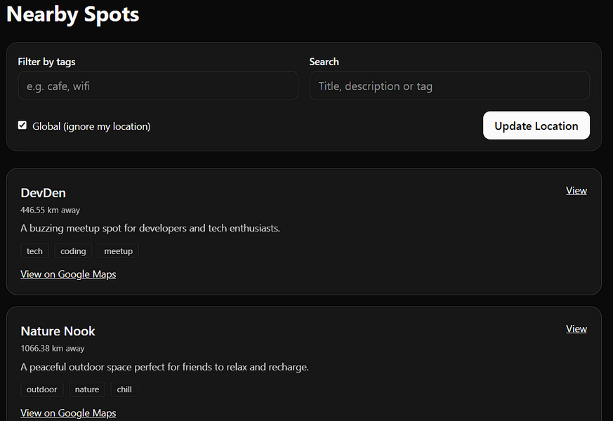
CORE FEATURES
  Spot Discovery
    Explore nearby public & private hangouts
  Community Interaction
    Discussion spaces for interest-based groups
    Share thoughts, collaborate, and connect
  Smart Search & Filters
    Find spots by tags, interests, and distance
  Personalized Experience
    Tailored spot suggestions based on community & activity
  Admin Management
    Keep spots organized with content & member moderation

Slide 5
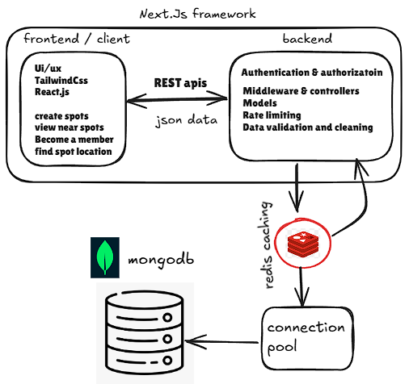
METHODOLOGY / ARCHITECTURE
  ⚡ Tech Stack
    Frontend: Next.js, Tailwind, ShadCN UI
    Backend: Node.js
    Database: MongoDB (geo + distance queries)
    Caching: Redis (fast queries, future chat state)
    Auth: Better auth.
  🛠 Architecture Highlights
    Community-driven discovery + interaction loop
    Redis offloads DB → boosts scalability
    Built for real-time growth (chat, gallery, payments)

Slide 6
RESULTS
  Current Outputs
    Nearby spots page fully functional
    Spot creation operational
    Distance calculations working in real-time
    Backend caching (Redis) improves performance
    Geolocation APIs integrated
  ⚙️ Technical Notes
    MongoDB used for geospatial queries
    Next.js + Tailwind CSS frontend
    Node.js + Express backend
    Responsive and modular architecture

Slide 7
CONCLUSION & FUTURE WORK
Key Takeaways
  Location-based discovery is stable
  Authentication and Authorization is working.
  Community-driven approach implemented
  Modular backend allows easy feature addition
🚀 Ongoing / Future Enhancements
  Time window for spots (admin-controlled)
  Role-based authentication (admin, user, moderator)
  Private & public spot access control
  Spot-specific chat (WebSocket + Redis)
  Gallery per spot (images & media)
  Payment gateway integration (Razorpay)
  Horizontal scaling for chat & high-load operations
  Analytics & monitoring for active spots and engagement

Slide 8
Thank you!
DISCOVER AND SHARE THE BEST AROUND YOU.

